Slide 1

Team 02
Knitted Fabric Manufacturing Machine Setup Data Challenge

Slide 2
Team Members
Resource Person - Dr. Shantha Jayalal
PS/2014/322 - P. D. A. Perera (TL)
PS/2014/269 – M. L. Weerarathne
PS/2014/366 – W. H. H. Fernando
PS/2014/195 – M. N. M. Rukshan
PS/2014/349 – W. W. P. M. T. M. Karunasena
PS/2014/265 – B. K. A. Erandi
SE/2014/036 – W. A. Y. Kavinda
SE/2014/054 – W. M. C. J. T. Kithulwatta

Slide 3



Introduction …
Place a fabric manufacturing order
Customer request values for (Design parameters)
PRL
PRW
Stretch
Assign a unique Design ID for the placed order

Slide 4
Fixed properties of the fabric manufacturing
Knit Per CM
Needle Setup
Machine Type
Number of Bands

Slide 5
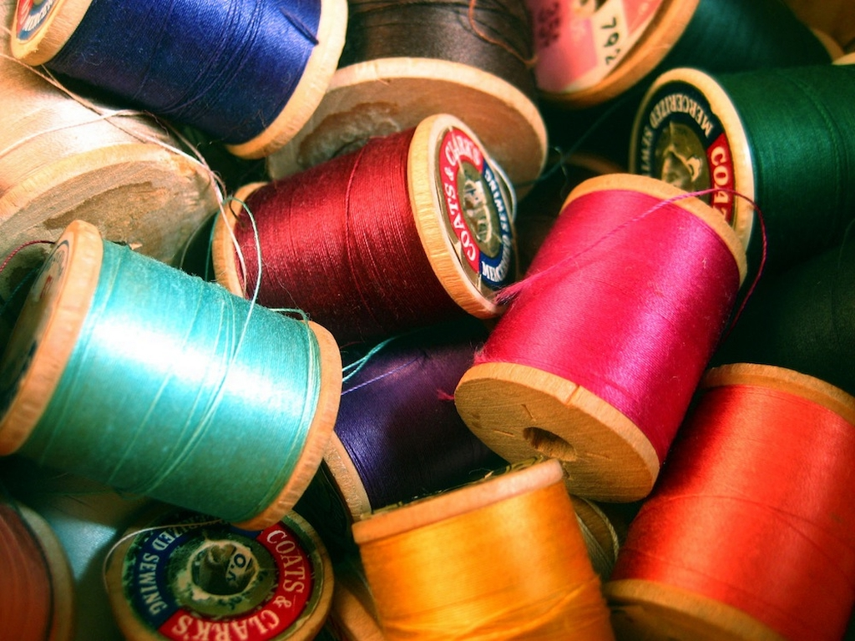
Yarns …
The fabric heavily depend on the row materials (yarns) .
A collection of 41 yarn types.
Number of different yarn types used for each fabric order.
Yarn tension rates needed to be setup for the knitting machine.
FRJ (Feed Rate Jarcard)
FRP (Feed Rate Pillar)
FRL (Feed Rate Lycra)
Design parameters
PRL (Pattern Repeat Length)
PRW (Pattern Repeat Width)
Stretch

Slide 6

Procedure …
Start to knit the ordered fabric in large scale
Set machine parameters
YES
Y₁
Y₂
Y₃
FRJ
FRP
FRL
NO
Do the design parameters equal or near to the Customer requested values
Fix the fabric properties
Measure design parameters
CONST
CONST
CONST
CONST
X₁
X₂
X₃
Knit Per CM
Needle Setup
Machine Type
Number of Bands
PRL
PRW
Stretch
MULTI VALUED
Count
MperRepeat
Percentage
Yarn types
Knit a sample of the ordered fabric

Slide 7
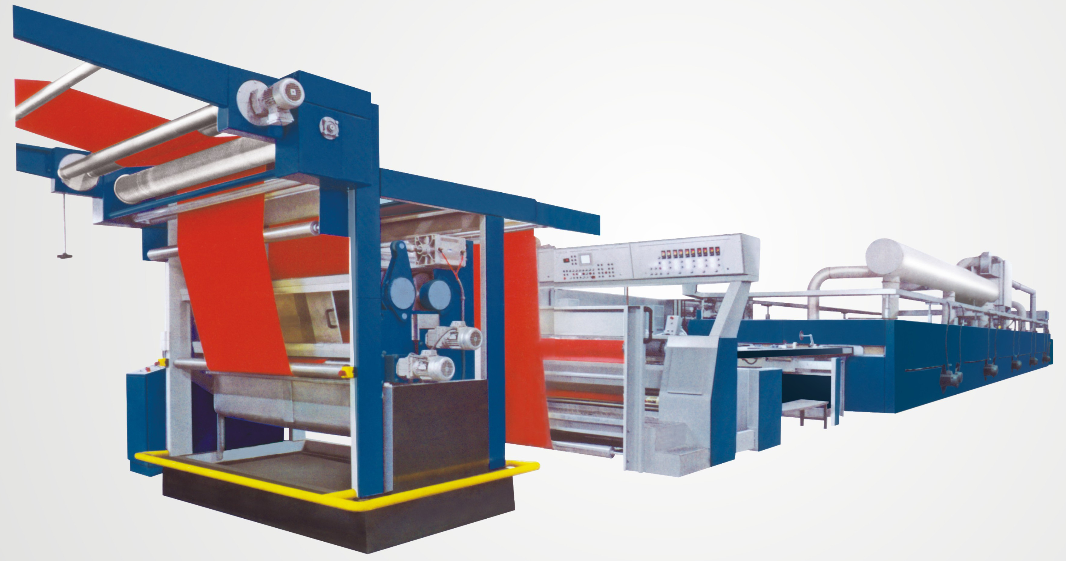
Problem Definition
Produce fabrics over 100m per sample
Needed more sampling to get the expected quality
Physical sampling is very costed

Slide 8

Solution
Reduce the number of sampling without manually
Get the required values (or near) for PRL, PRW and Stretch for the fabric order
Setup the knitting machine parameters correctly

Slide 9


Phases
Data preparation
Model training
Prediction
Improvement

Slide 10
Data Preparation
Identify the relationship between data sets.
Design Table
1
Design_ID
*
1
Result Table
*
*
Design_ID
Yarn_consumption Table
*
Design_ID

Slide 11
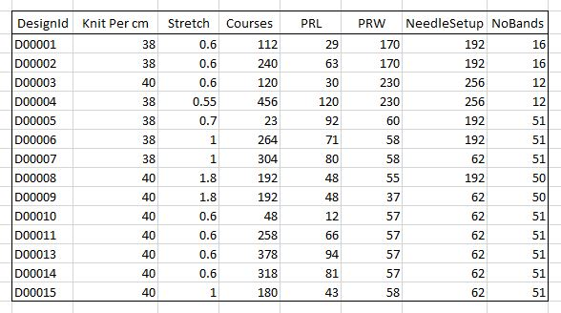
Data Preparation (Cont’)
Merging data sets
Design.csv

Slide 12
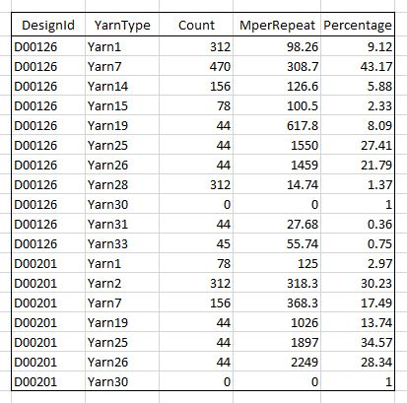
Data Preparation (Cont’)
Yarn_consumption.csv
Merging data sets

Slide 13
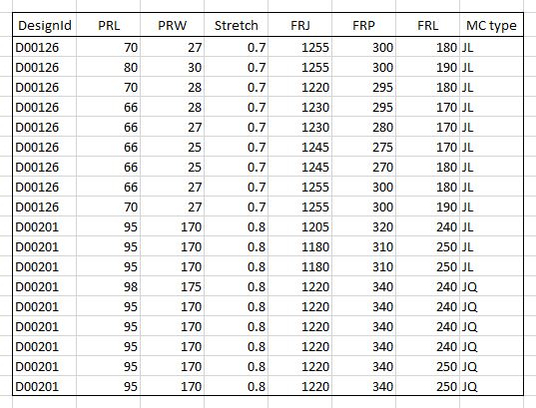
Data Preparation (Cont’)
Results.csv
Merging data sets

Slide 14
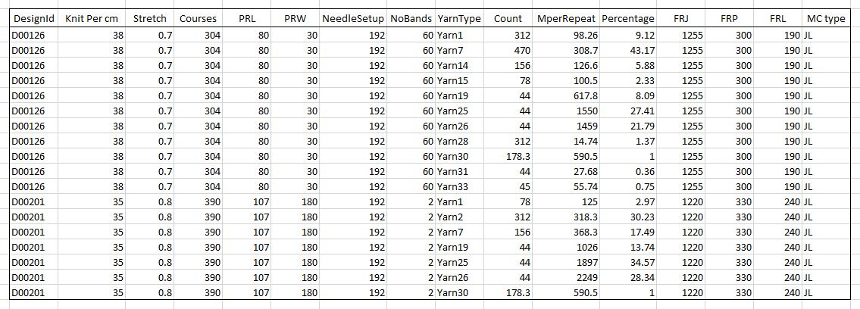
Data Preparation (Cont’)
Merging data sets
Final_dataset.csv

Slide 15

Data Preparation (Cont’)
Cleaning the data set
Missing Data Remove each rows
Data Outliers Assign the average
Cleaned data set
For fitting the model
Training data set – 80%
Test data set – 20%

Slide 16
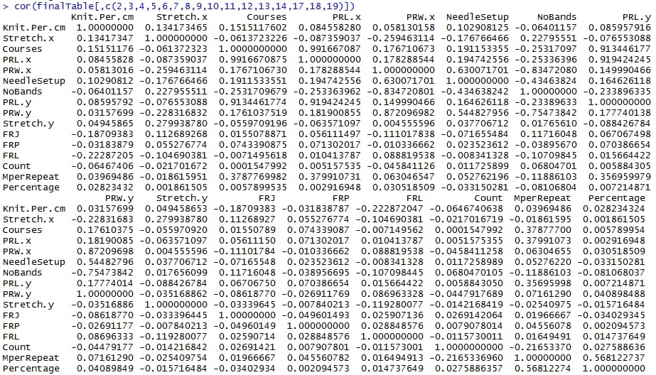
Correlation Table
Stretch
PRL
PRW
CORRELATED
FRJ
FRL
FRP

Slide 17
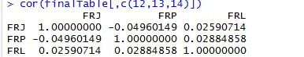
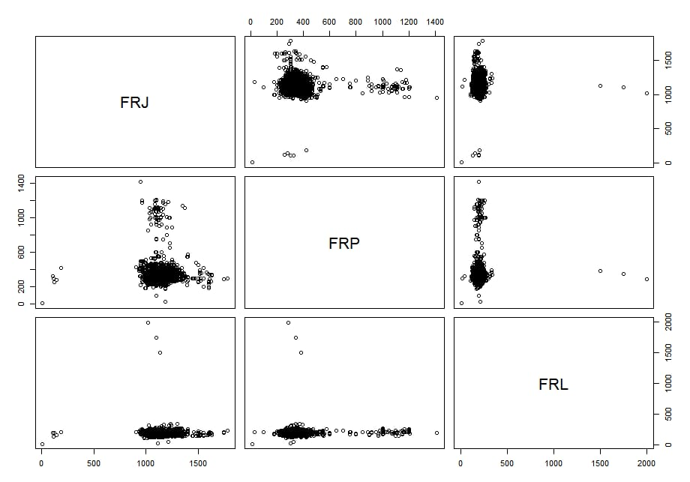
Correlations …
According to the each correlation graphs, there is no strong correlation among these three variables because;
The observations are spread over the graph
The fitted model is parallel to the X or Y axis
So, We select FRJ, FRP, FRL as the Response variables.

Slide 18
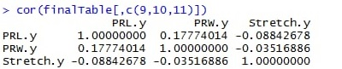
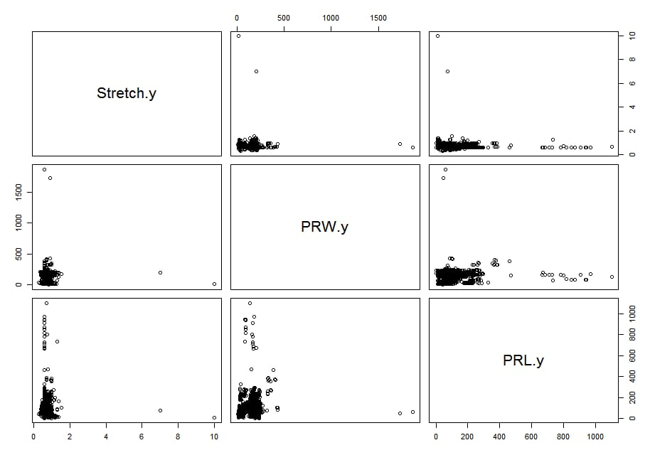
Correlations …
According to the each correlation graphs, there is no strong correlation among these three variables because;
The observations are spread over the graph
The fitted model is parallel to the X or Y axis
So, We select FRJ, FRP, FRL as the Predictor variables.

Slide 19
Model Training & Prediction
According to the problem we have;
Response Variables
FRJ
FRP
FRL
Predictor Variables
PRL
PRW
Stretch

Slide 20
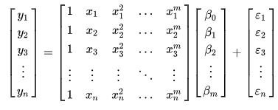
Model Training (Cont’)
Multiple polynomial Regression
Equation Form
Matrix Form

Slide 21
Assumptions …
There is no dependencies among the independent variables.
The relationship between the response variable (Y) and the predictor variable (X) is polynomial.
The errors are independent, normally distributed with mean zero and a constant variance.

Slide 22
Model Training (Cont’)
3 Fitted Multiple Polynomial Models
lm.fit4=lm(FRJ~polym(Stretch,PRW,PRL,degree = 4,raw = T),train)
lm.fit5=lm(FRP~polym(Stretch,PRL,PRW,degree = 3,raw = T),train)
lm.fit6=lm(FRL~polym(Stretch,PRL,PRW,degree = 4,raw = T),train)

Slide 23
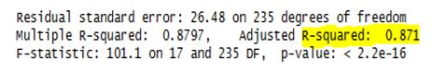
Model Training (Cont’)
FRJ against PRL,PRW,S
The best model that data fitted is polynomial with degree 4 under R² value 0.8710.
87.10% indicates that the model explains all the variability of the response data around its mean.

Slide 24
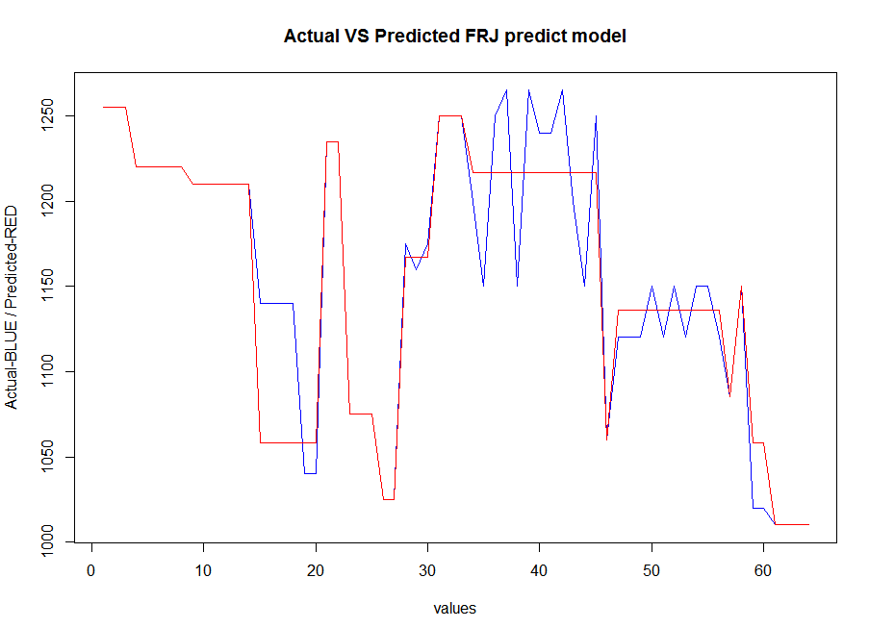
Prediction (Cont’)

Slide 25
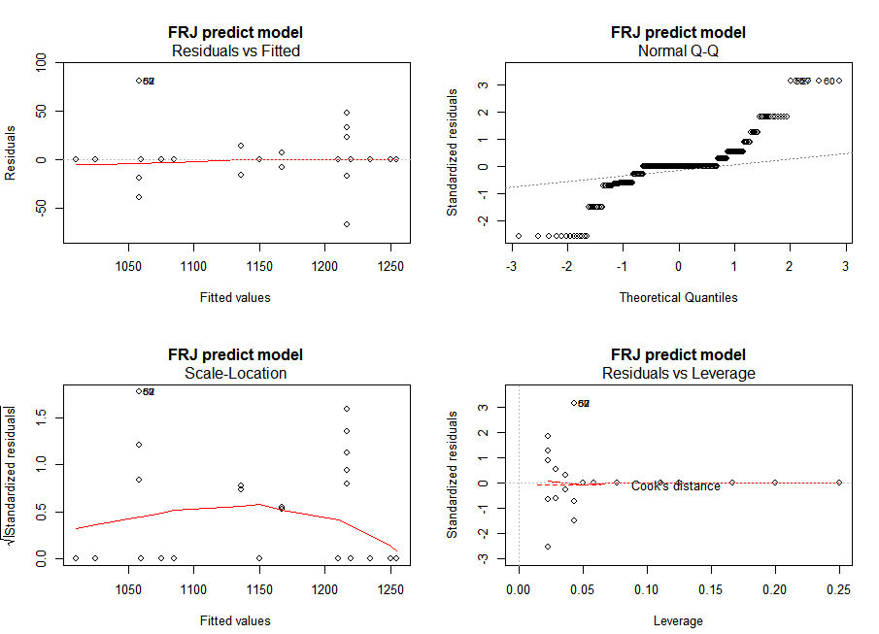
Prediction (Cont’)

Slide 26
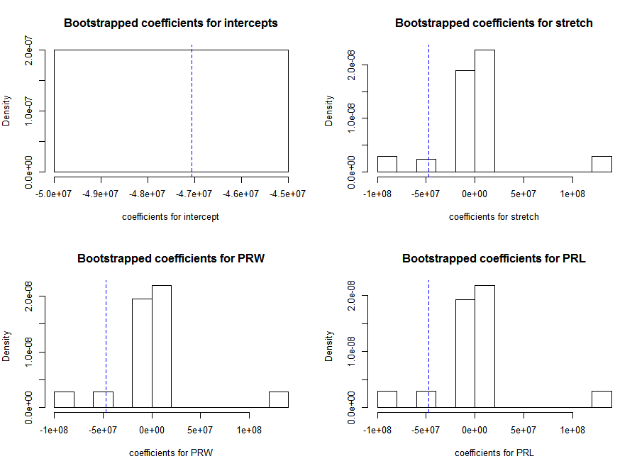
Bootstrap FRJ predictive model

Slide 27
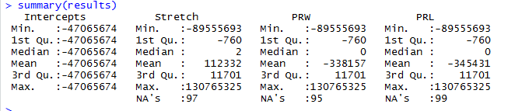
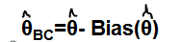
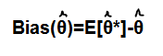
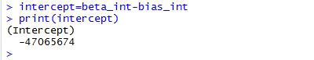
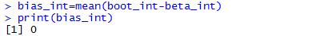
Bias(θ)=E[θ*]-θ

Slide 28
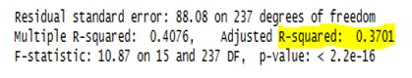
Model Training (Cont’)
FRP against PRL,PRW,S
The model that data fitted is polynomial with degree 3 under R² value 0.3701.
37.01% indicates that the model explains all the variability of the response data around its mean.

Slide 29
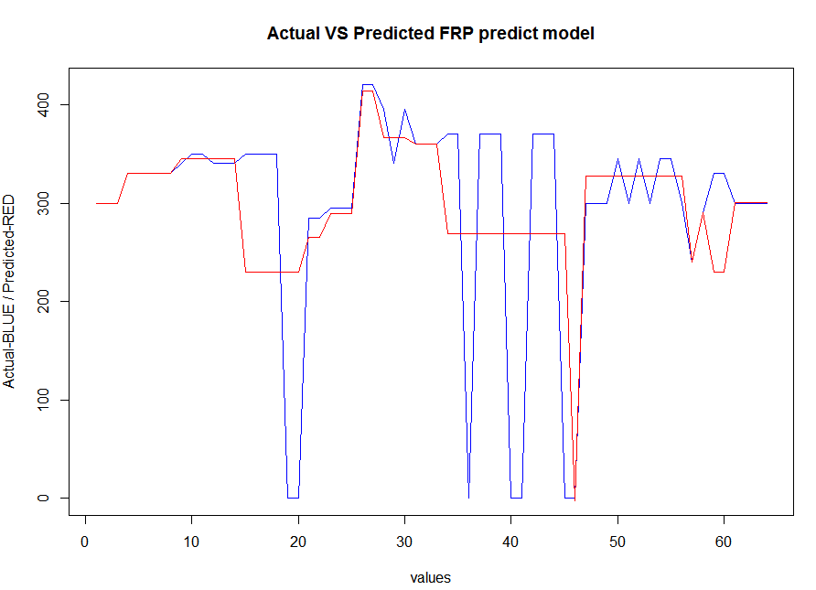
Prediction (Cont’)

Slide 30
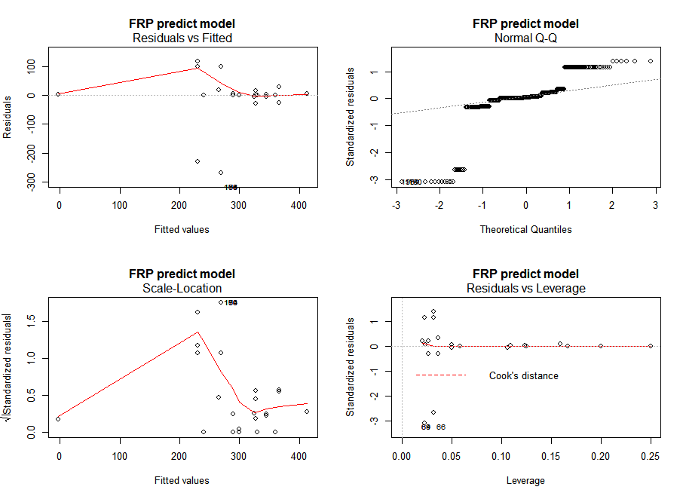
Prediction (Cont’)

Slide 31
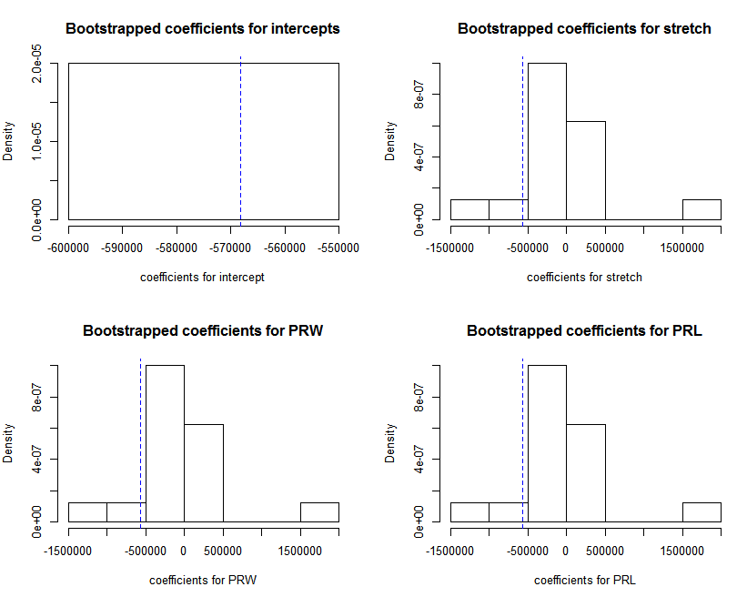
Bootstrap FRP predictive model

Slide 32
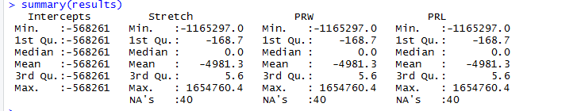
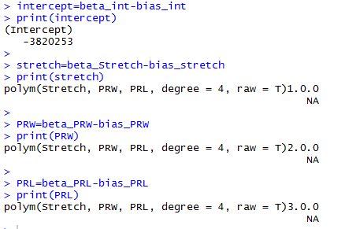
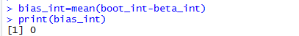
Bias(θ)=E[θ*]-θ

Slide 33
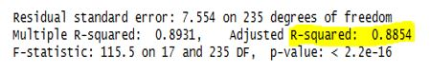
Model Training (Cont’)
FRL against PRL,PRW,S
The best model that data fitted is polynomial with degree 4 under R² value 0.8854.
88.54% indicates that the model explains all the variability of the response data around its mean.

Slide 34
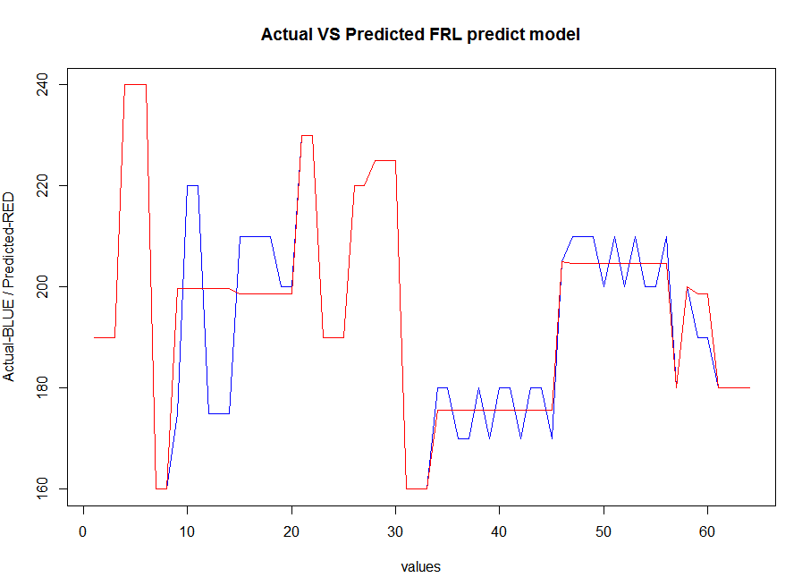
Prediction (Cont’)

Slide 35
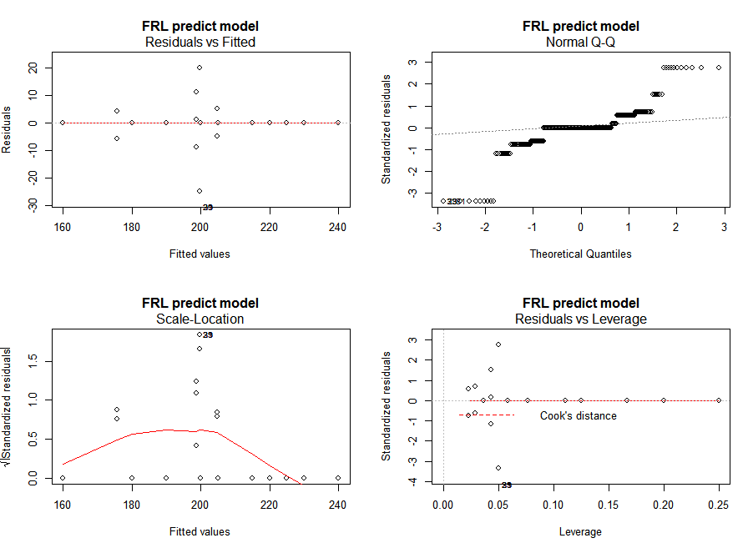
Prediction (Cont’)

Slide 36
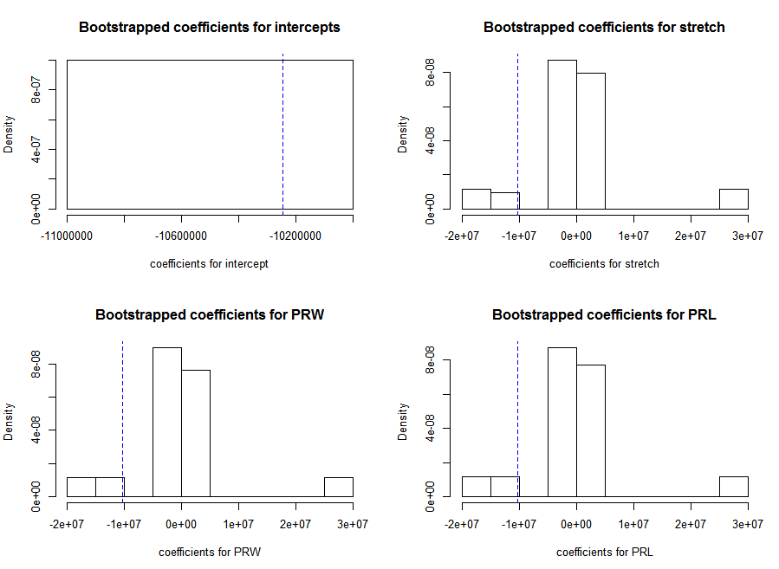
Bootstrap FRL predictive model

Slide 37
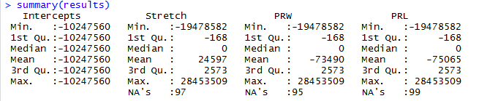
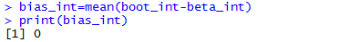
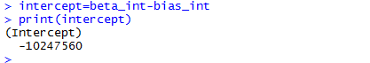
Bias(θ)=E[θ*]-θ

Slide 38

Lets see the Demonstration …

Slide 39
Improvement
For future development
This stage is used to increase the accuracy of the prediction.
For that case, we can follow many ways.
Use Statistical Data Binning
Try other suitable Machine Learning Model
The form of Quantization to group a number of continuous values into a small number of Bins.
Support Vector Machine Model
Neural Networking

Slide 40
Challengers …
Find the relationships between data sets , merge them and clean the merged data set
Find the dependencies of each variables of the data set.
Find the degree of the polynomial function of each response variable.
Increase the accuracy of the data model

Slide 41
Limitations …
Time Limitation
Due to the less time (One week) we couldn’t pretreat the Dataset (Scaling) and try out other Machine Learning Models.

Slide 42
References …
😉
https://en.wikipedia.org/wiki/Polynomial_regression
https://stats.stackexchange.com/questions
Dr. Gardener, M. (2012) Beginning R the Statistical Programming language. Canada, John Wiley & Sons, Inc.

Slide 43


Questions …

